Slide 1

Capstone Project Day April 9, 2022 The mater calculator
Software System Engineering
Group 1
Presented by Philip A. Anyuon

Slide 2
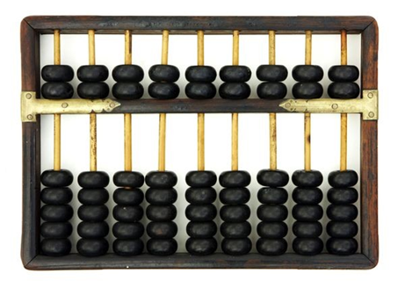
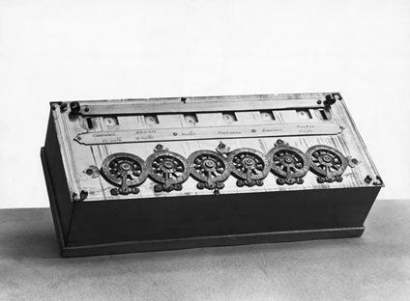
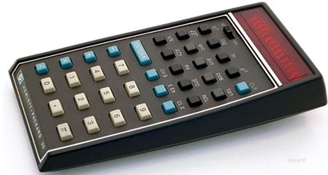
Calculator Background
Hewlett Packard (HP) 35 Electronic Calculator
Abacus
Pascal Calculator
Many things in a live need a calculation, human need a calculator to do those things.

Slide 3

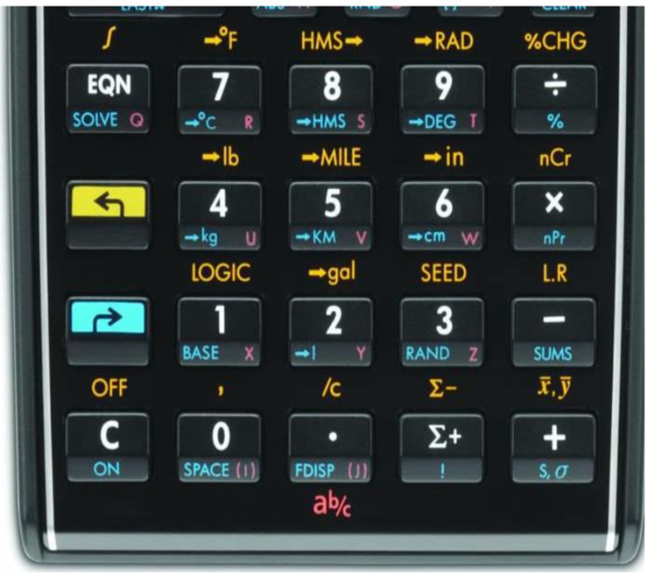
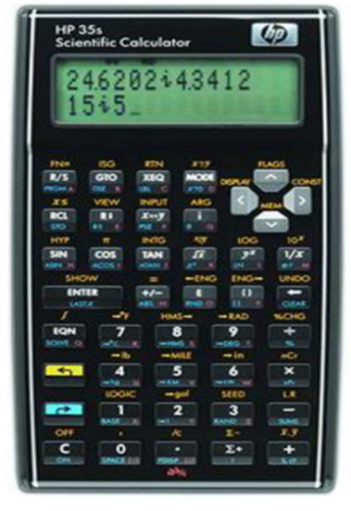
Calculator Background
HP 35s Scientific Calculator

Slide 4
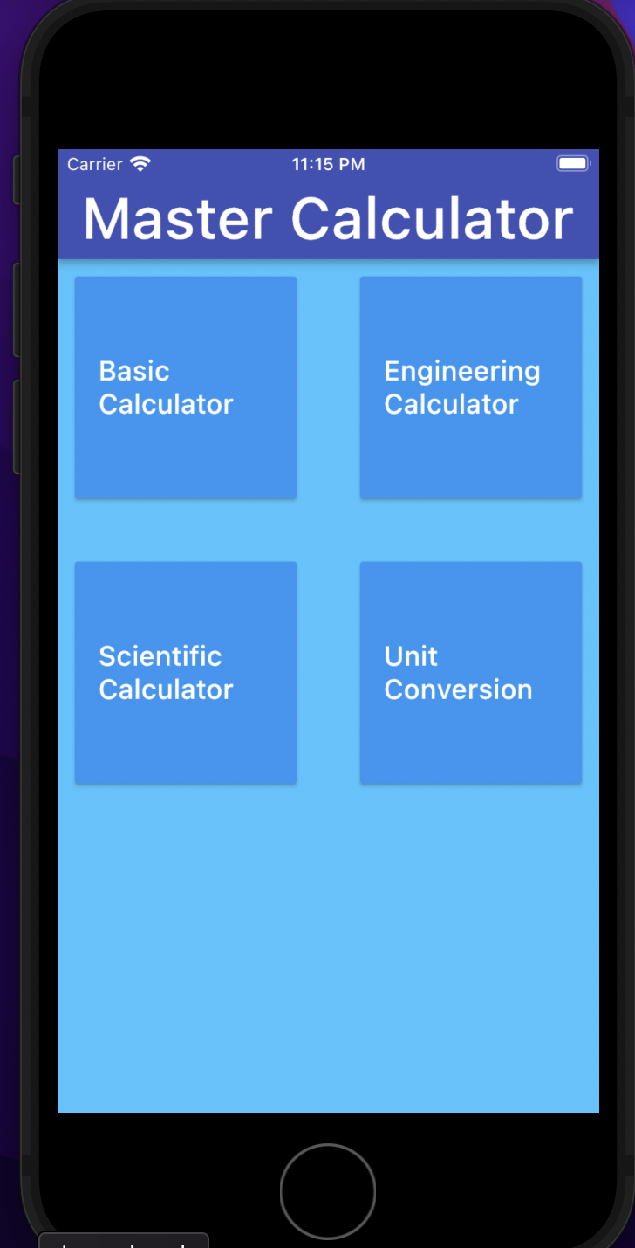
The Master Calculator
The Master Calculator is mobile and web application. It runs across platform system, i.e. Android, iOS, Window, Mac, and Linux.

Slide 5




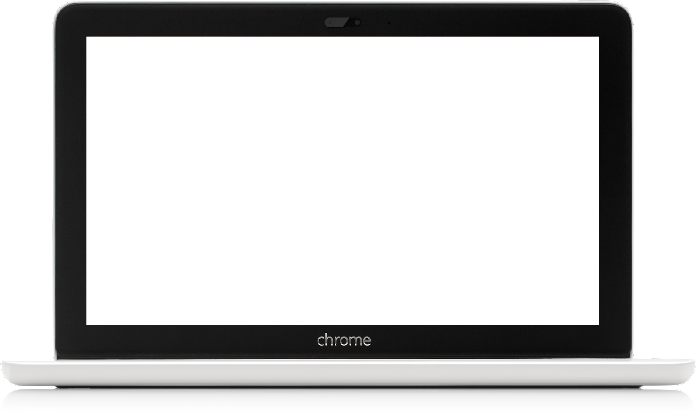

The master calculator is a mobile and web application
That means it can work on your cell phone as well
Android or iPhone all the same

Slide 6
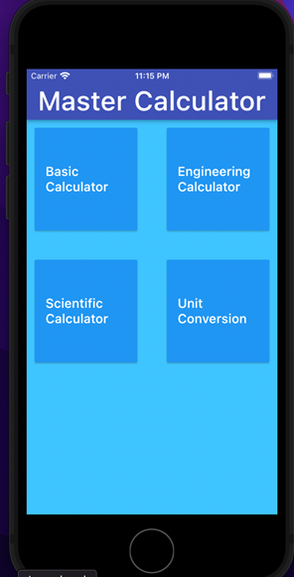
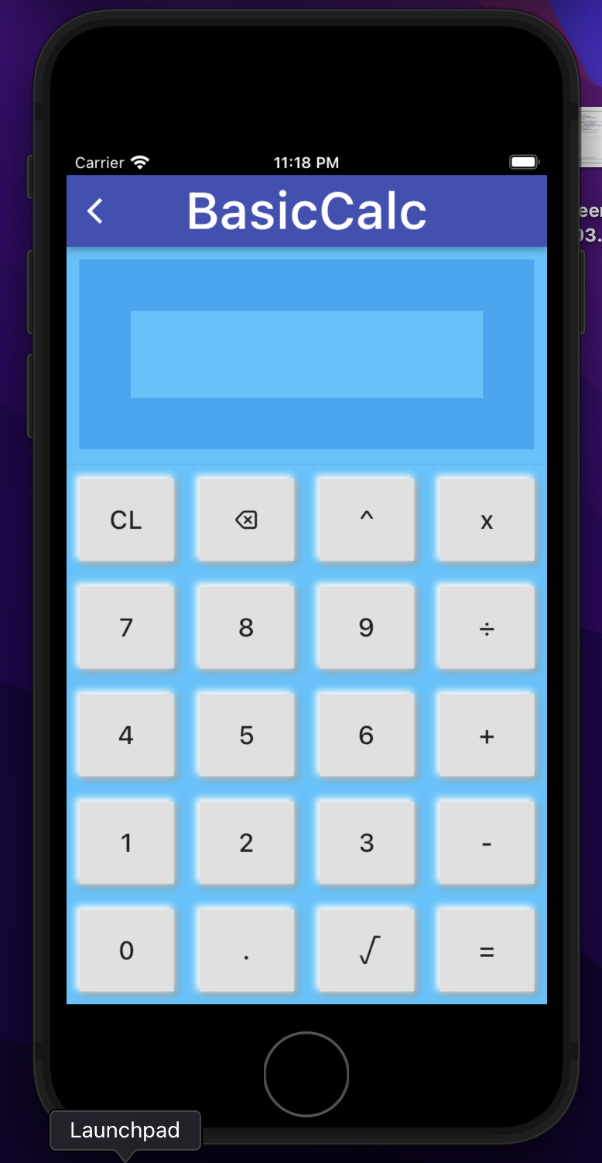
How does it work?
Basic calculator
By navigation
Basic calculator where you can do a simple calculation
navigate

Slide 7

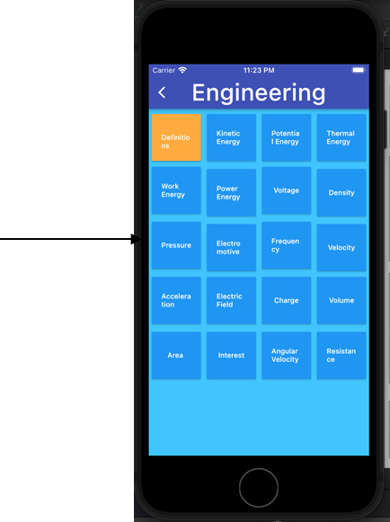
How does it work?
Engineering calculator

Slide 8
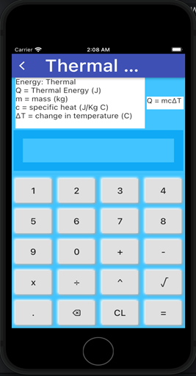


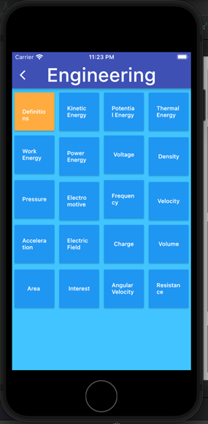
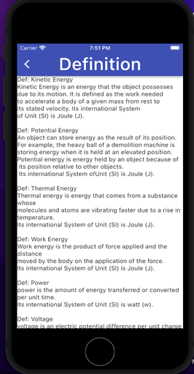

How does it work?
Engineering calculator

Slide 9
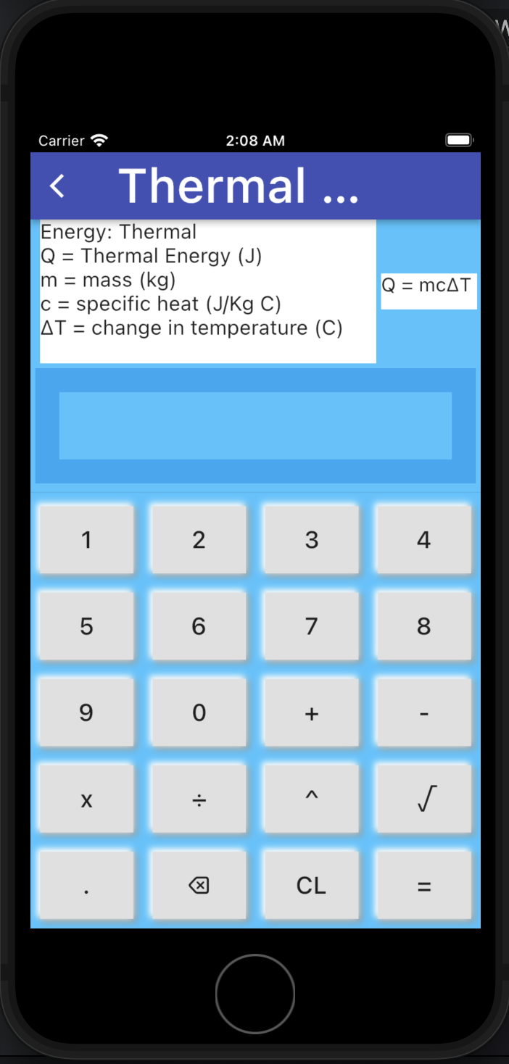

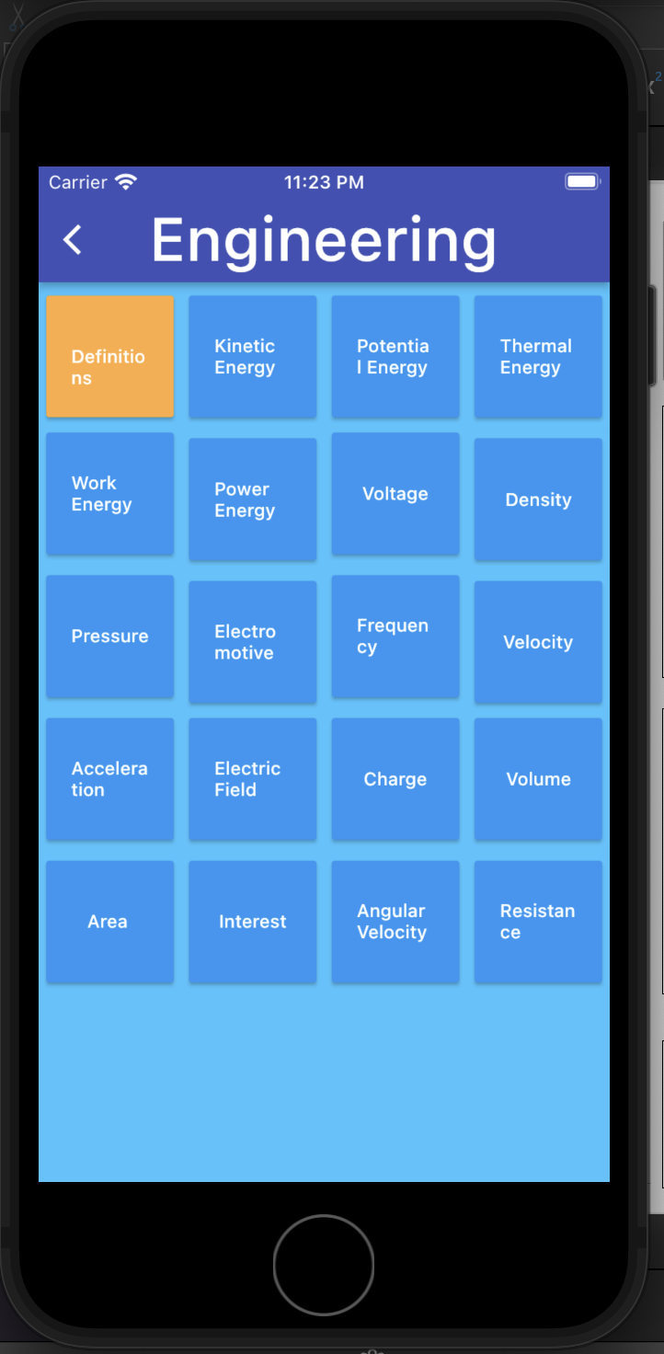
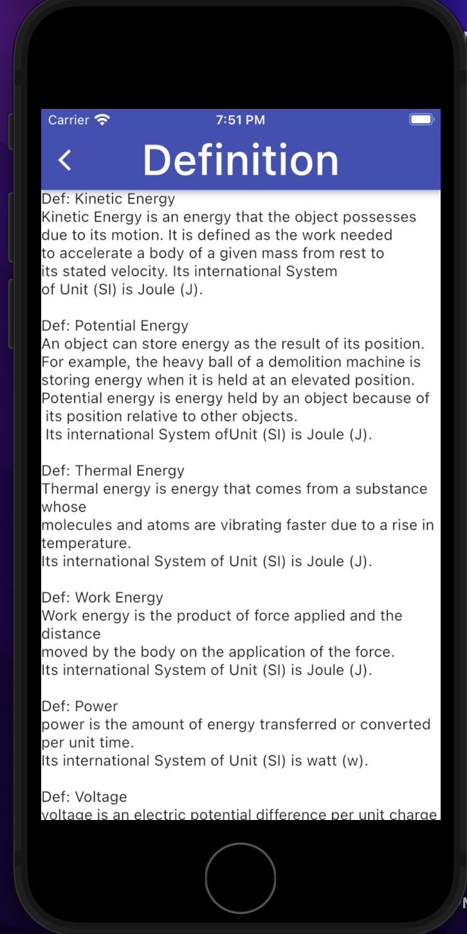
How does it work?
Engineering Calculator
requirements
formula
A user has to associate the problem with the process
Must need the following:
1.A mass in kg
2.Specific heat in (J/kg. C)
3.Change in temperature (C)
4.You need a formula (mc∆T)
Definition of terminologies

Slide 10

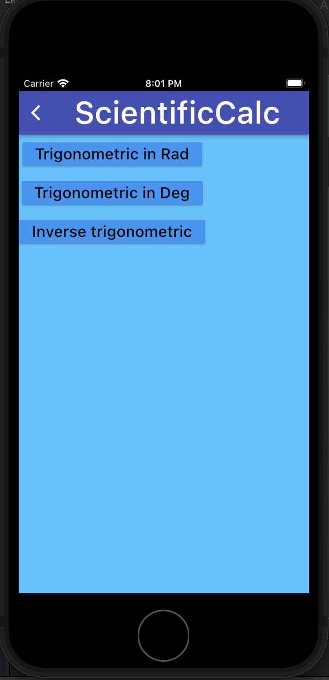
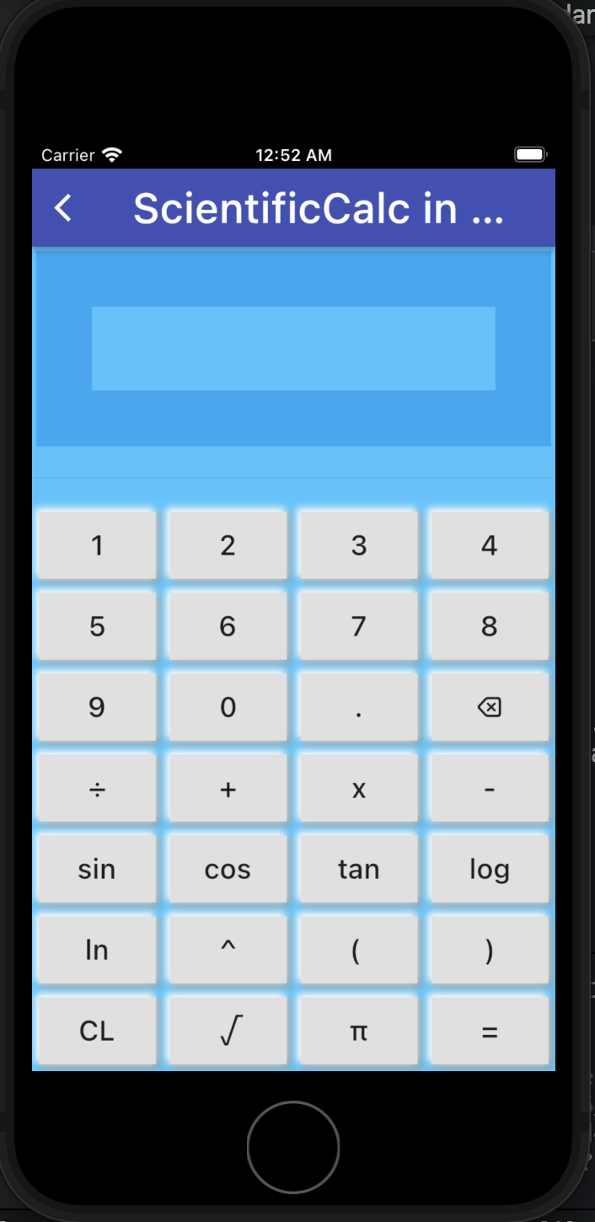
How does it work?
Scientific calculator

Slide 11
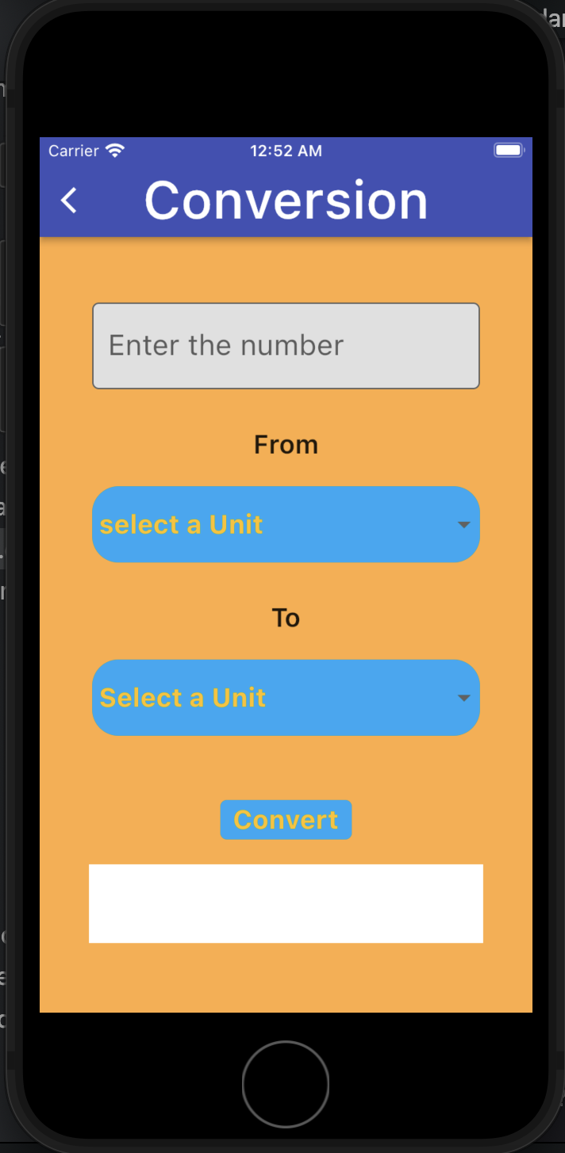
How Does it work?
Many things going wrong because the unit conversion was not properly use or was completely ignored
Navigate to unit conversion

Slide 12
The technology used for development
The master calculator app was developed from flutter open-source framework. Flutter uses a programming language called dart, which was created by google in 2011. it uses a google User Interface (UI) toolkit for building a native compiled application for mobile and web from a single codebase. Many developer use it today.

Slide 13
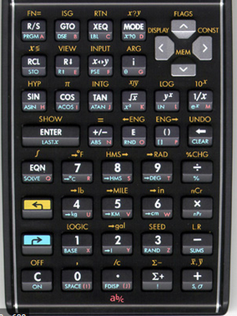
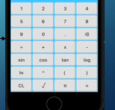
In the Summary
Why do we need the master calculator?
It is less complex. You don’t need a 2ndF or mode to derive the calculation. It is a straight forward by just press the function and the number or number and operator
If you need a confusion go here
Here there is no confusion

Slide 14
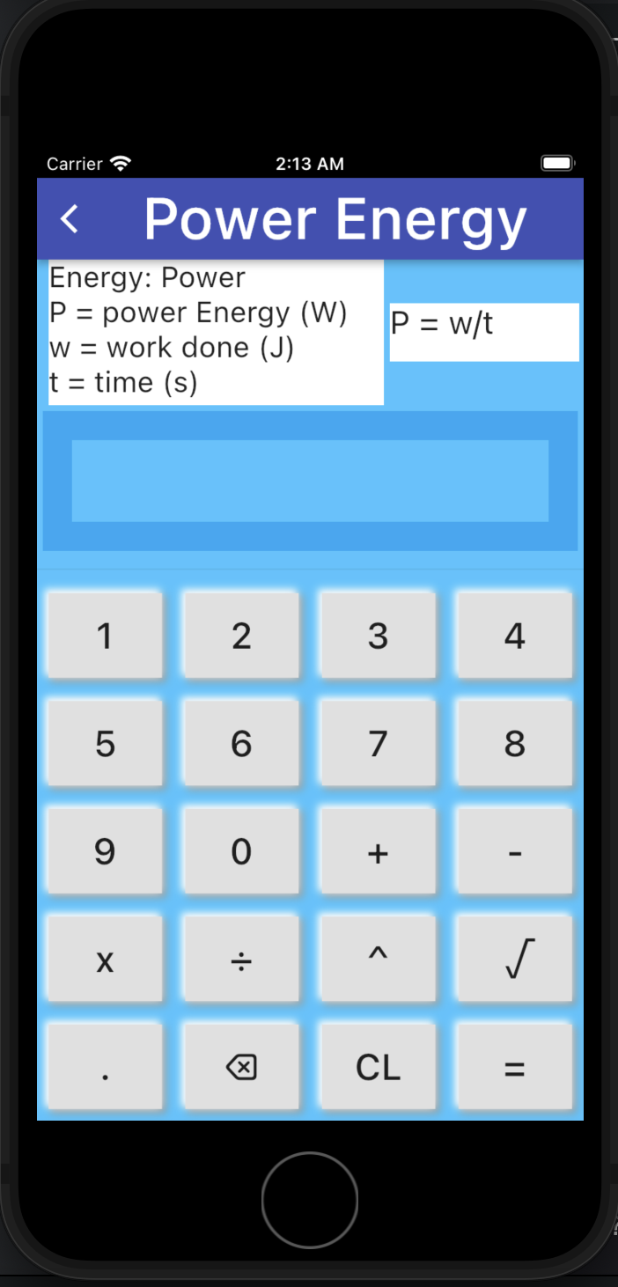
2. You don’t need a physical calculator.
Master calculator operates on mobile phone or on computer. You don’t need a calculator, just downloaded it to your devices and you are good to go.
3. You don’t need Wi-Fi.
Master calculator doesn’t need Wi-Fi at all.
4. The master calculator take a minimum of megabyte in your device, that mean you don’t need to be worried about the downloading space.
5. The user will associate the problem with the process while using this calculator. All variables required for each calculation are provides. Example, calculation of power, the requirements variables are
provides.

Slide 15
6. It is easy to add more functions and features to master calculator without interferences with the previous features or functions on it. Almost all features are independent, so, you can add any feature without any problem.
7. The master calculator will be a library of many things related to calculation.
8. You will find a definition of terminologies which are already mentioned in the calculator.
9. It has a unit conversion as well.

Slide 16
References
Whitney. T., (1995-2021). Inventor of the World’s First Scientific Handheld Calculator. Retrieved on April 5, 2021, from https://www.ece.iastate.edu/profiles/thomas-m-whitney/
The Museum of HP Calculators: 1972-1975. Retrieved on April 5, 2022, from https://www.hpmuseum.org/hp35.html
The Versatile, Venerable Abacus. CHM Computer History Museum. Retrieved on April 5, 2022, from https://www.computerhistory.org/revolution/calculators/1/1
Shree Swaminaryan Gurukul and Zundai (2020). Puna International School. Class _V Supercomputer Year – 2020-21. Derived on April 5, 2022n from http://punainternationalschool.com/assets/upload/ck-images/class_V_Comp%20_Ch-1%20Explanation.pdf

Slide 17
The end
Questions.

